Slide 1
Day 3 – Microservices Training
Tatyasaheb Patil Nikhil Damle
Amar Durga
November – December 2021

Slide 2
Microservices Security
The importance of security in microservices
Spring Security
Basic Authentication
How to secure a microservice using Basic Authentication
Access Token Concepts
OAuth 2.0
Open ID Connect
2

Slide 3
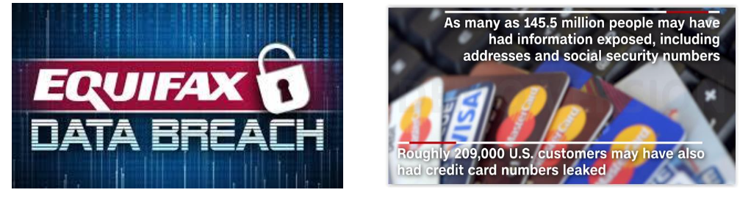
Why Security is Important?
Equifax – Credit Bureau
One of the largest credit bureaus, Equifax(EFX), was hacked and personal data of 145 million people was stolen.
It is considered among the worst breaches of all time as sensitive data including Social Security numbers was exposed.
3

Slide 4

Why Security is Important?
Yahoo

Slide 5
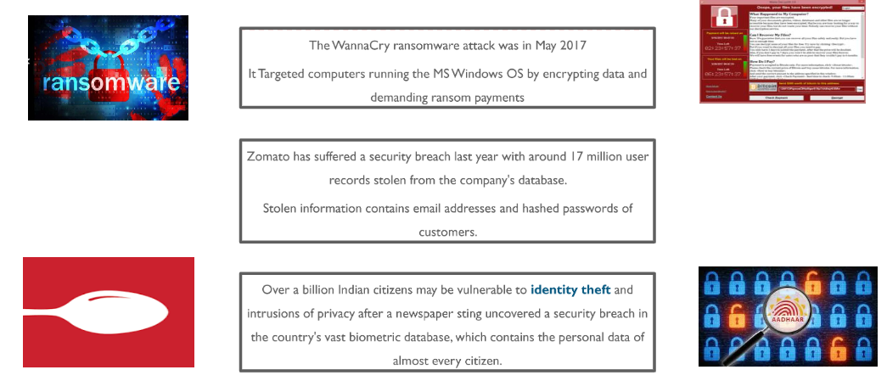
Why Security is Important?
Indian Breaches

Slide 6
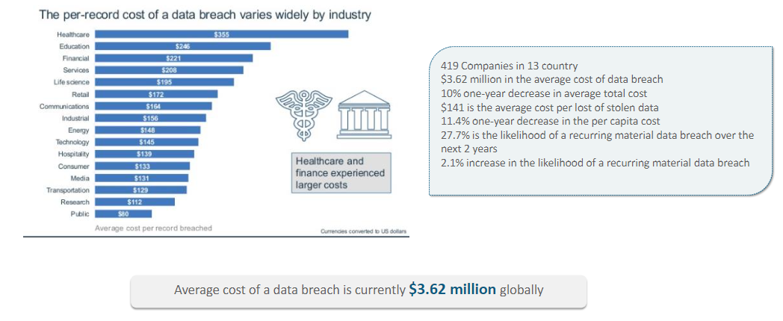
Why Security is Important?
Cost of Data Breaches

Slide 7
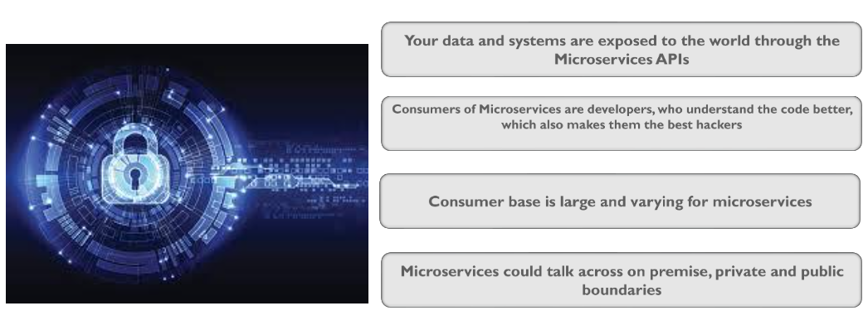
Securing Microservice

Slide 8
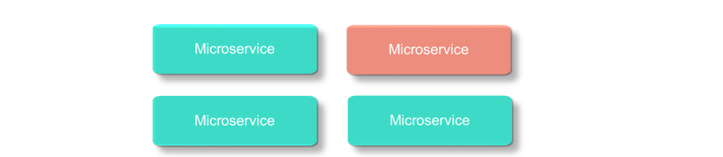
Segregate Sensitive Information
Sensitive information needs to be segregated.
The number of microservices that will process this data must be reduced as much as possible.
Dedicated microservices can be created for processing, storing customer personal identifiable information and securing the personal customer data as no other component will have access to it.
Microservice reduces the risk of data mishap through Isolation.

Slide 9
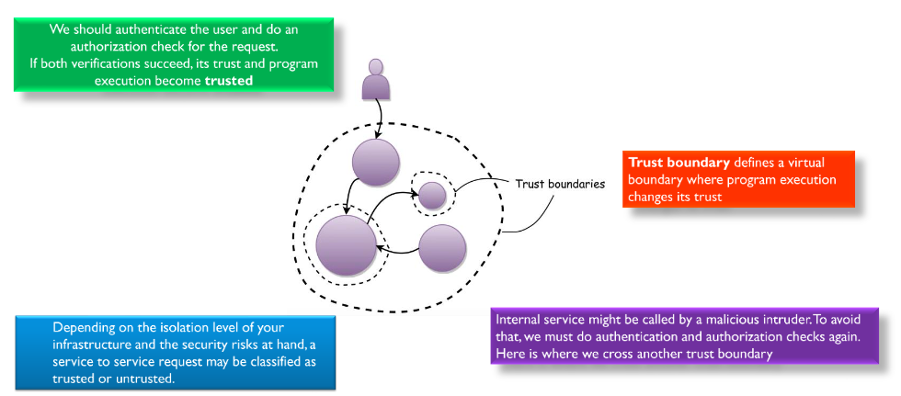
Introduce Trust Boundaries

Slide 10
Best Practices
Provide Least Privilege
Use the principal of Least Privilege – provide the minimal access that is required by one service to complete the job.
Discover and monitor inter-service communications
Observing inter-service communication is a way to establish the baseline for policies by understanding application behaviour. Service discovery is the process which enables automatic identification of new services to other entities in the application.

Slide 11
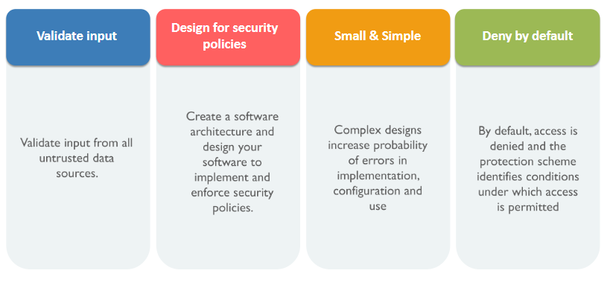
Use Secure Code Practice

Slide 12
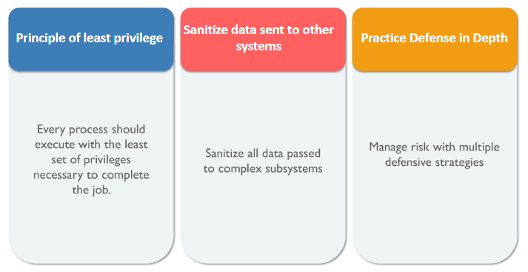
Use Secure Code Practice

Slide 13
Security Protocols / Types / Methods
Basic Authentication
MD5 Digest Based Authentication
OAuth 2.0
Open ID Connect

Slide 14
Spring Security
Spring Security is a powerful and highly customizable authentication and access-control framework. It is the de-facto standard for securing Spring-based applications.
Spring Security is a framework that focuses on providing both authentication and authorization to Java applications.
Like all Spring projects, the real power of Spring Security is found in how easily it can be extended to meet custom requirements

Slide 15

Spring Security
Stateless REST requests
UI
Third Party Applications
Micro Services Application
Programmatic access
Workflow applications
Spring Security Layer

Slide 16
Basic Authentication
This is the most straightforward method and the easiest. With this method, the sender places a username:password into the request header.
The username and password are encoded with Base64, which is an encoding technique that converts the username and password into a set of 64 characters to ensure safe transmission.
This method does not require cookies, session IDs, login pages, and other such specialty solutions, and because it uses the HTTP header itself, there’s no need to handshakes or other complex response systems.
Here’s an example of a Basic Auth in a request header:
Authorization: Basic bG9sOnNlY3VyZQ==

Slide 17
Spring Security
Stateless REST requests
UI
Third Party Applications
Micro Services Application
USERNAME : PASSWORD
USERNAME : PASSWORD
Programmatic access
Workflow applications
Spring Security Layer

Slide 18
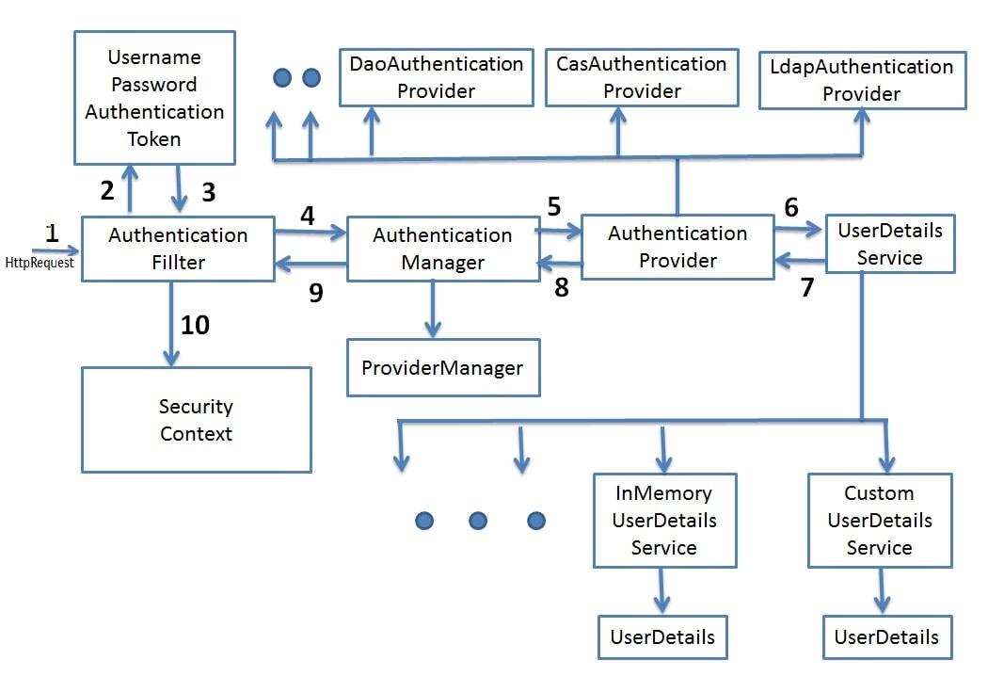
Spring Security – Basic Authentication

Slide 19
Spring Security – Basic Authentication

Slide 20
Spring Security – Basic Authentication
Lets look at a Basic Authentication Implementation example……

Slide 21
Digest based Authentication
Digest authentication is another authentication type specified in HTTP protocol.
Unlike basic authentication, digest authentication does not require the password to be transmitted in plain text.
The client takes the username and password and uses the MD5 hashing algorithm to create a hash.
HA1 = MD5(username:realm:password)
HA2 = MD5(method:digestURI)
response = MD5(HA1:nonce:HA2)

Slide 22
Spring Security - Digest Authentication
Stateless REST requests
UI
Third Party Applications
Micro Services Application
MD5 DIGEST header
MD5 DIGEST header
Programmatic access
Workflow applications
Spring Security Layer

Slide 23
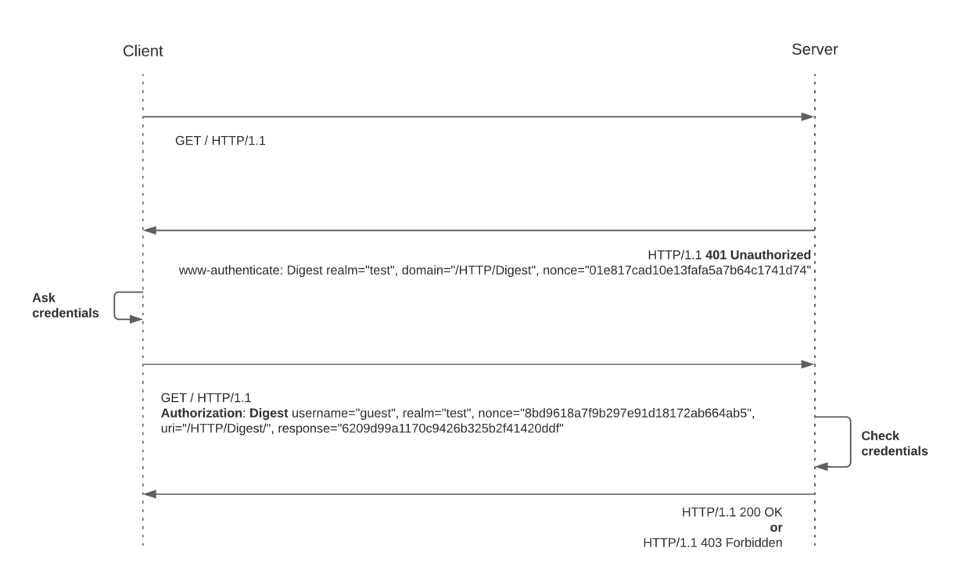
Spring Security - Digest Authentication

Slide 24
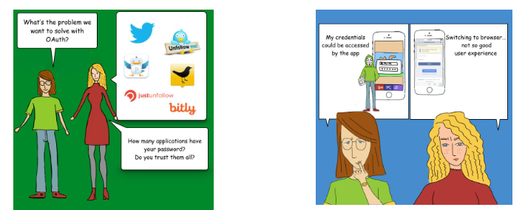
OAuth 2.0
OAuth 2.0 is an open authorization protocol, which allows accessing the resources of the resource owner by enabling the client applications on HTTP services such as third provider party Facebook, GitHub, etc.
It allows sharing of resources stored on one site with another site without using their credentials.

Slide 25
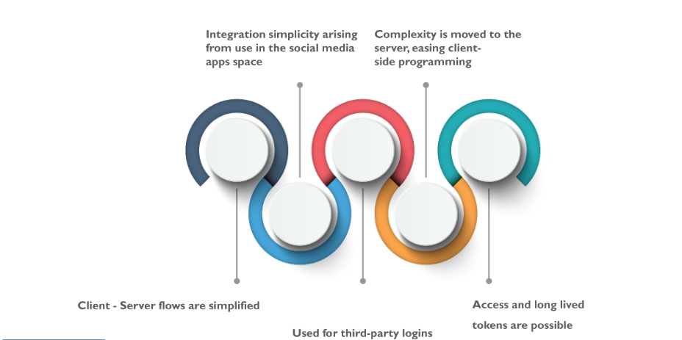
OAuth 2.0

Slide 26
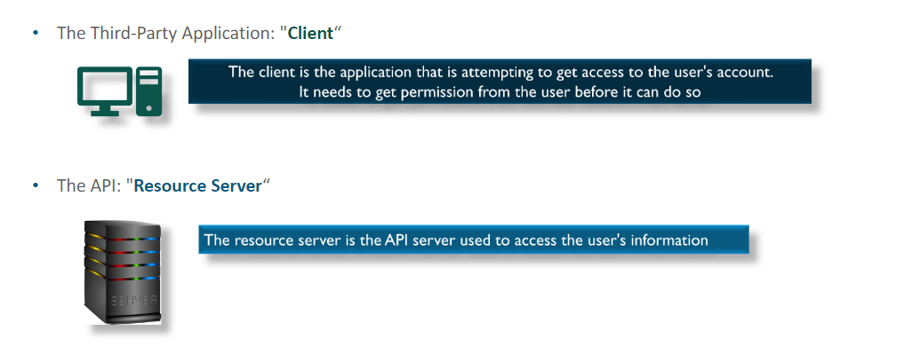
OAuth 2.0
OAuth 2.0 Roles

Slide 27
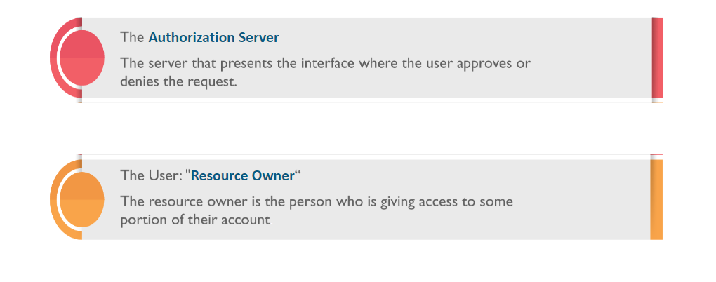
OAuth 2.0
OAuth 2.0 Roles

Slide 28
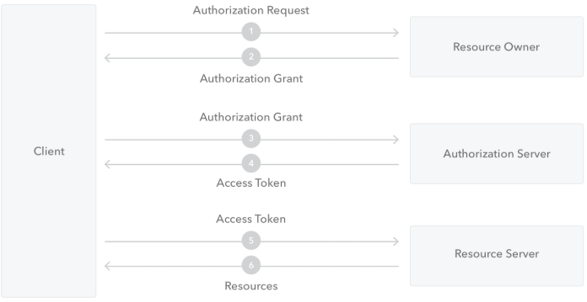
OAuth 2.0
User
Auth API
App
OAuth 2.0 workflow

Slide 29
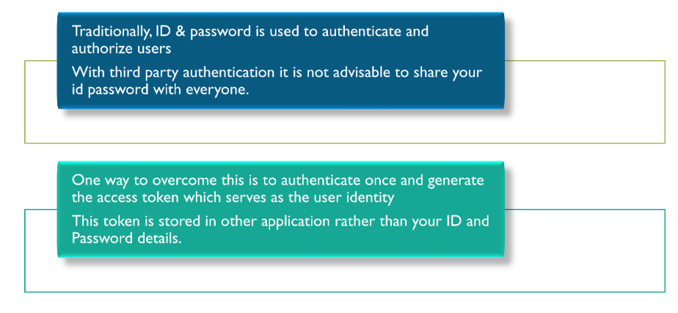
OAuth 2.0
Access Token – Why?

Slide 30
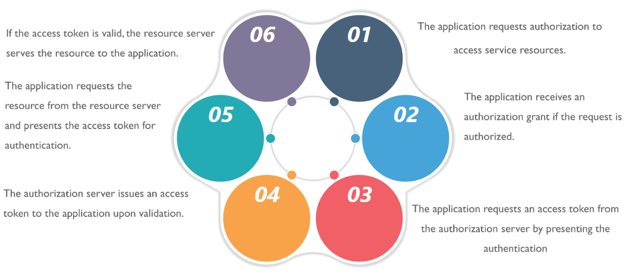
OAuth 2.0
How the Token Works

Slide 31
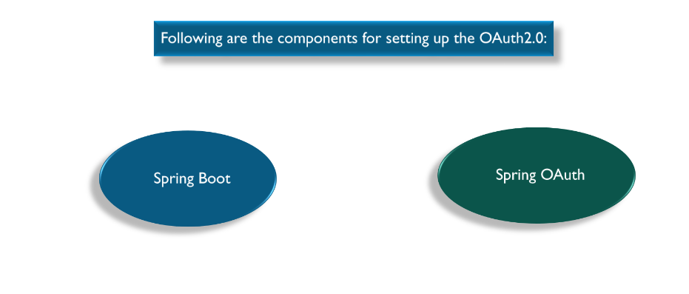
OAuth 2.0
Securing with OAuth 2.0

Slide 32
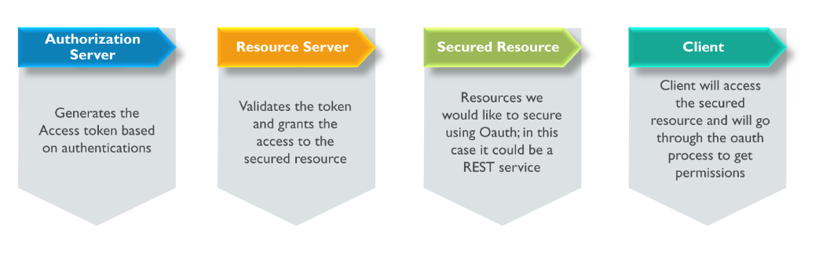
OAuth 2.0
OAuth Components

Slide 33
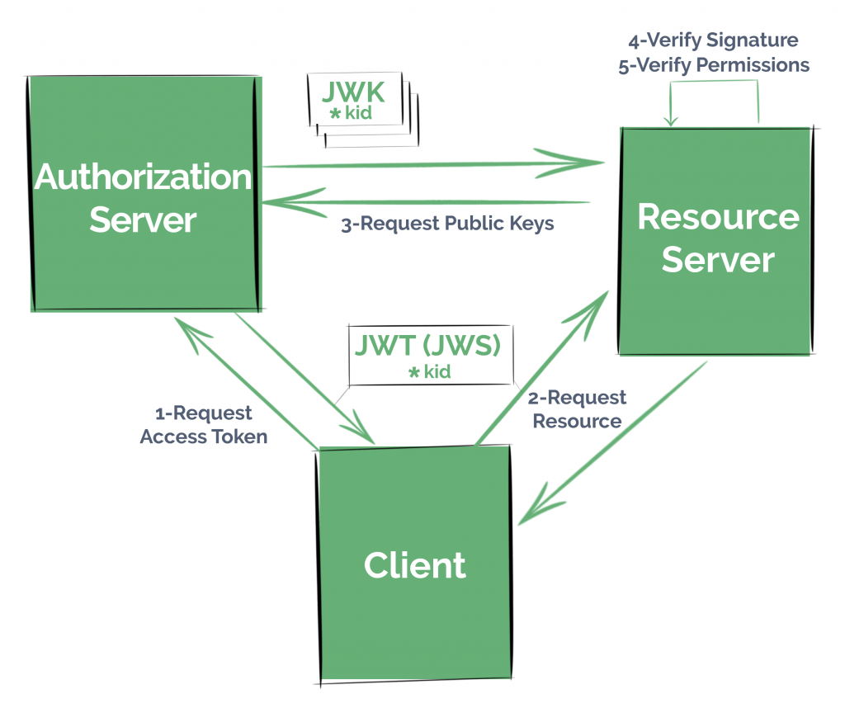
Open ID Connect

Slide 34
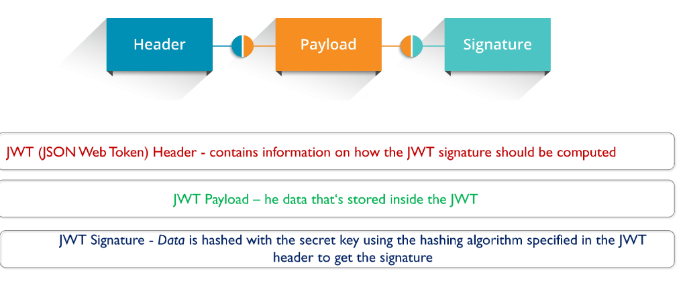
Open ID Connect
How does a JWT Access Token Looks

Slide 35
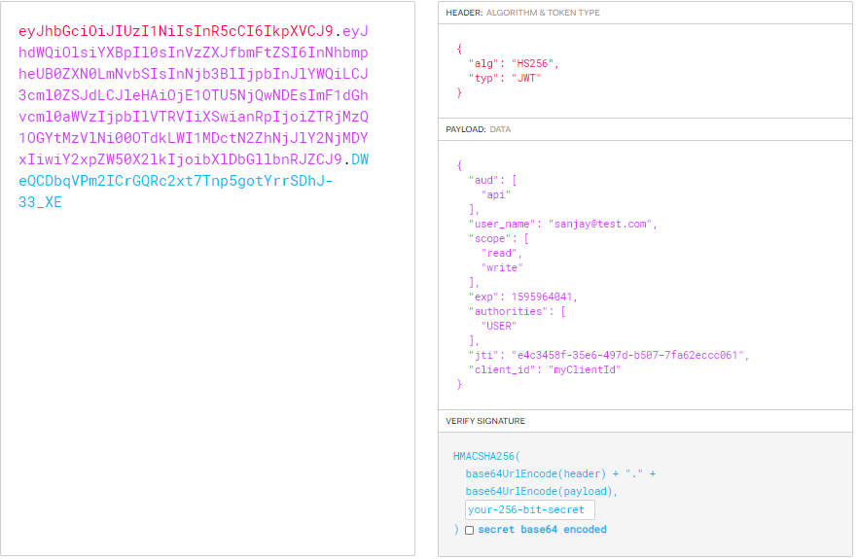
Open ID Connect

Slide 36
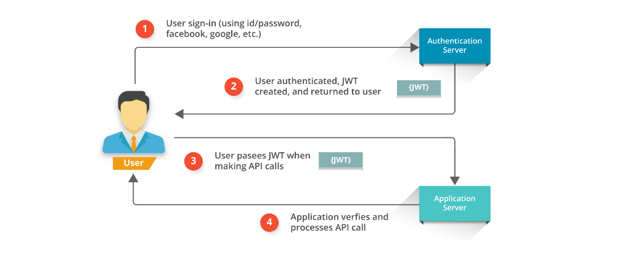
Open ID Connect
How the Token Works

